Slide 1
[NBMP] Live Media Ingest
Rufael Mekuria (USP)
Dirk Griffioen (USP)
Arjen Wagenaar (USP)
Kevin Johns (Level 3)
Nikos Kyriopoulos (Media Excel)

Slide 2
On this contribution
- Highlight a problem in the industry and raise awareness
- Highlight key use case in NBMP
- Explore the best place for the standardization work item, we prefer MPEG NBMP
- Reflect shared vision on this problem
- Improved input contribution in the next meeting to help finalize NBMP CfP
- Involve live encoder vendors, CDN, broadcasters, many interest from their side

Slide 3
Live Video Streaming
e.g. origin server
Live encoder
A
Media Processing
CDN
Client
[NBMP]
Encoder ingest
interop
point
Publishedformat:
DASH
HLS
Smooth
Publishedformat:
DASH
HLS
Smooth
Live Encoders: Telestream, elemental, harmonic, MediaExcel etc….

Slide 4
Limitation of DASH, no push based, only client
e.g. origin server
Live encoder
A
Media Processing
CDN
Client
Push
segments
[NBMP]
Encoder ingest
interop
point
Publishedformat:
DASH
HLS
Smooth
Publishedformat:
DASH
HLS
Smooth
Azure defines own ingest specification:
https://docs.microsoft.com/en-us/azure/media-services/media-services-fmp4-live-ingest-overview

Slide 5
Timed meta data
e.g. origin server
Live encoder
A
Media Processing
CDN
Client
SDI
signal
Push
segments
Publishedformat:
DASH
HLS
Smooth
Publishedformat:
DASH
HLS
Smooth
SCTE 35
ID 3 tags
Azure defines own ingest specification:
https://docs.microsoft.com/en-us/azure/media-services/media-services-fmp4-live-ingest-overview

Slide 6
Redundancy encoder/processing failover
Live encoder
A
e.g. origin server
Media Processing
CDN
Client
Live encoder
B
Media Processing
CDN
Client
Live encoder
C
[NBMP]
Encoder ingest
interop
point
Published format:
DASH
HLS
Smooth
Published format:
DASH
HLS
Smooth

Slide 7
Standardization of live encoder ingest
e.g. origin server
Live encoder
Media Processing
Client
[NBMP]
Encoder ingest
interop
point
Published format:
DASH
HLS
Smooth

Slide 8
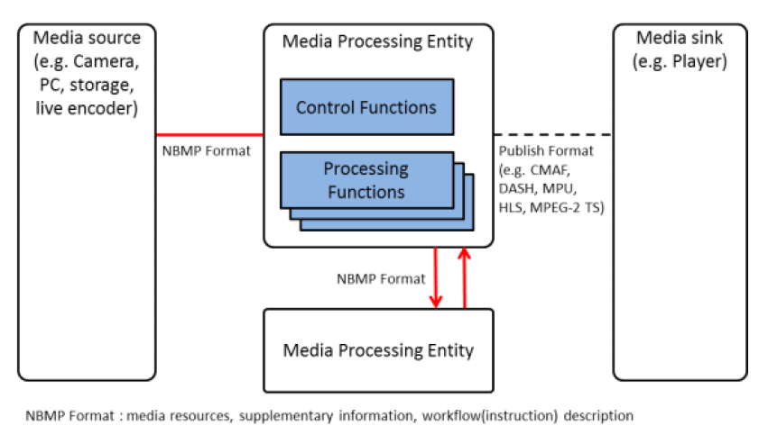
NBMP Framework
We need the tranport spec too for industry interop!

Slide 9
Standardization of live encoder ingest
- Timed Meta Data (SCTE, ID3)
- Push based content ingest of media segments (preferably TCP/HTTP based)
- Clock synchronization
- Redundancy failover and procedures for restart
- Low latency (?)
CMAF based ?
Adopted in NBMP CfP ?

Slide 10
Requirements (inline with NBMP)
1. The ingest format shall support push based transmission of live stream events
2. The ingest format shall support timed meta data such as based on ID3 and SCTE-35
3. The ingest specification shall support ingest of MPEG-H and MPEG-4 media including
HEVC, AVC, AAC, MPEG-H audio and other media formats
4. Media ingest shall be in fragments (moof box and mdat) as specified by ISOBMFF
5. The ingest specification stream shall use clock synchronization between streams, preferably on
UTC timestamps form the original (SDI) signal
6. The ingest specification shall be based on MPEG technologies and container formats
7. The ingest spec shall specify failover and restart procedures to gracefully restart in case of failovers
8. The ingest spec document shall specify best practices for encoder redundancy and service redundancy
9. (i.e. continuation of the live event after failure of encoder or service node)
10. The ingest specification shall support gracefull teardown of ingest of live stream events

Slide 11
Recommendation for NBMP
- Check the timelines for CfP
- Adopt the live encoder ingest specification as a key use case (including timed meta data and failover)
- Make sure the NBMP requirements are mapped to key use cases, discuss how to do this
Gather industry support on the matter in the coming period: Broadcasters, Encoder vendors or CDNs
Proponents may not be interested in other use cases
Low latency support will be a big discussion item

